Slide 2
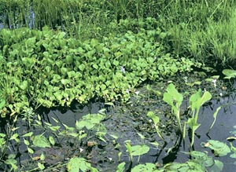
Plant Biodiversity
M A Baset Mia
Department of Crop Botany
BSMRAU, Gazipur
Bangladesh
Genetic variability of plant within a specific area

Slide 3
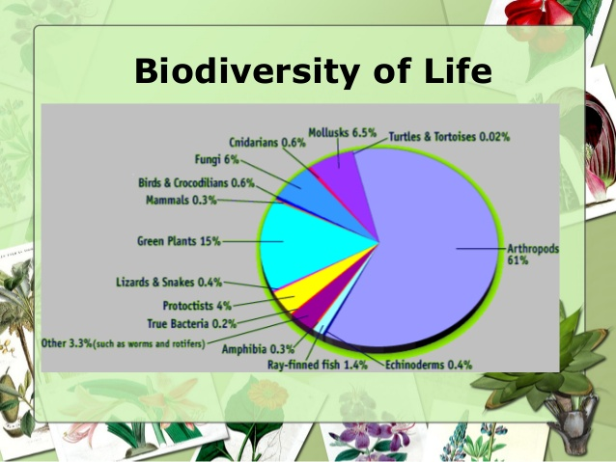

Slide 4
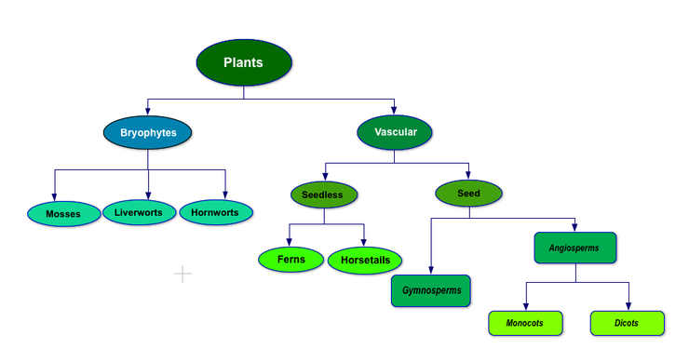

Slide 5
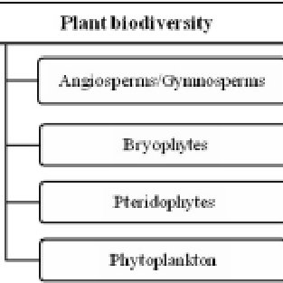

Slide 6
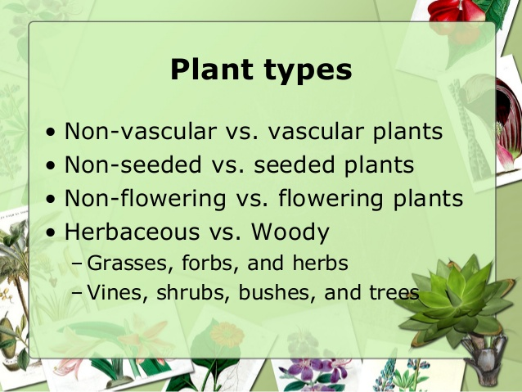

Slide 7
Types of Biodiversity
Species diversity
Genetic diversity
Ecological diversity

Slide 8
Measuring of Biodiversity
Alpha diversity: This is the diversity in species, i.e. the number of species within a community. This depends on the interaction between the biotic and abiotic factors and also takes into account immigration from other locations.
Beta diversity: The change in the composition of the species with reference to the changes in the environment.
Gamma diversity: This refers to the overall diversity and is applied to larger areas in which both alpha and beta diversity are measured.

Slide 9
Importance / Value of Biodiversity
Environmental Value
Consumptive Value
Productive Use Value
Social Value
Ethical and Moral Values
Aesthetic Value
Optional Value

Slide 10
Causes of Biodiversity Loss
Increasing population
More deforestation than plantation
Conservation of wetlands in terrestrial system by landfills
Pollution of water bodies
Global climate changes including increasing troposphereic UV-B and ozone levels
Discarding of hundreds of traditional varieties
Narrowing spectrum selected hundreds of traditional varieties

Slide 11
Overexploitation of medicinal plants
Destruction representative habitats
Illegal trading of wildlife and their products
Lack of proper environmental education
Overexploitation of some wild plant for various economic consideration
Very poor enforcement of legislation

Slide 12
How to conserve biodiversity
In situ protection
Ex-situ conservation
Ex-situ culture

Slide 13
Important Agencies Handling Conservation
World Conservation Monitoring Center (WCMC, UK) Collaborative with UNEP
World Conservation Union (IUCN-Switzerland)
Worldwide Fund for Nature (WWF)
FAO Commission on Plant Genetic Resources (FAO)
International Board for Plant Genetic Resources

Slide 14
Methods for maintained of biodiversity
Red Data Book
Endangered
Vulnerable
Rare

